Slide 1



Synthesis and Performance Optimization of a Switching Nano-crossbar Computer
Mustafa Altun, PhD
Electronics & Communication Engineering
Istanbul Technical University
Web: http://www.ecc.itu.edu.tr/
June 13th, 2016
Marie Skłodowska-Curie Actions (MCSA) Info Day, Istanbul

Slide 2
Outline
Project details
  Consortium
  Objectives
  Impact
  Implementation
Technical details
Specifics of MCSA RISE
  Pros, cons, and suggestions
Lessons learned
  Proposal preparation and consortium formation
  Implementation
Project’s contribution to research and career

Slide 3
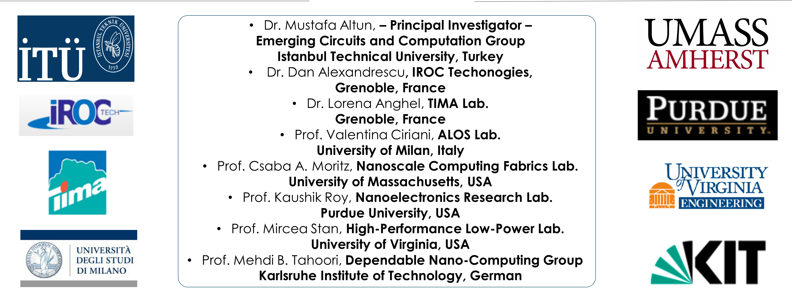
Project Details - Overview
Gathers globally leading research groups working on nanoelectronics and electronic circuit design and design automation
Targets variety of emerging technologies including nanowire/nanotube crossbar arrays, magnetic switch-based structures, and crossbar memories
Contributes to the construction of emerging computers beyond CMOS by proposing nano-crossbar based computer architectures.
Budget: 724500 EURO

Slide 4
Objectives
A circuit design project targeting emerging
Theoretical, computational, and experimental research
Complementarity and synergy among project participants

Slide 5
Timeline

Slide 6
Technical Details - Motivation
1963: CMOS
1965: Moore’s Law
  Transistor count doubles every year.
1975: Moore’s Law updated
  Transistor count doubles every two years.
2015: Gordon Moore: «I see Moore’s law dying here in the next decade or so»
2015: Intel confirming the slowdown in pace of advancement, from two to two and a half years.
  Uncertainty, probabilistic phenomena
  Fabrication challenges
New technologies emerge: nano-crossbar arrays

Slide 7


Emerging Transistors
Nanowire transistor
Single electron transistor
Carbon nanotube transistor
Spin based transistor
Quantum well transistor
Direct and safe replacement of CMOS transistors
Some advantages over CMOS
Interconnection problems
Lack of integration
“We can't solve problems by using the same kind of thinking we used when we created them.” - Albert Einstein

Slide 8

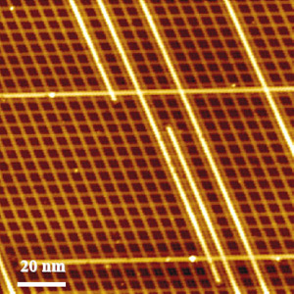
Nano-crossbar Arrays
Regular arrays
  Regularity; ease of design.
Nanotechnology
  Self-assembled systems.
Self-assembled circuit with 64,000 elements in three minutes
Self-assembled nanowires

Slide 9
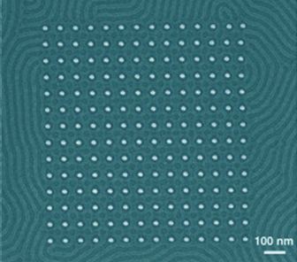
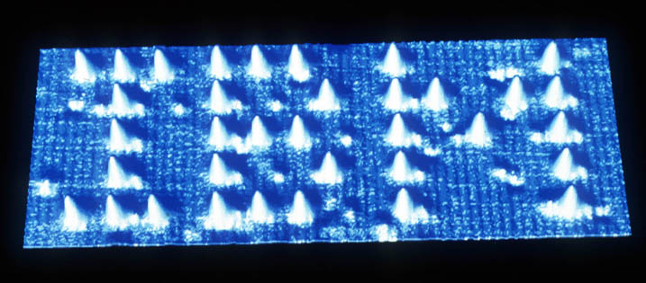
Why Self-assembly?
Directed assembly
  Advantages
    Results in a functional construct from a print/layout
  Disadvantages
    Costly in nanoscale
    Time consuming
Self assembly
  Advantages
    Fast and efficient in nanoscale
    Results in condensed structures
  Disadvantages
    Not results in a functional construct

Slide 10
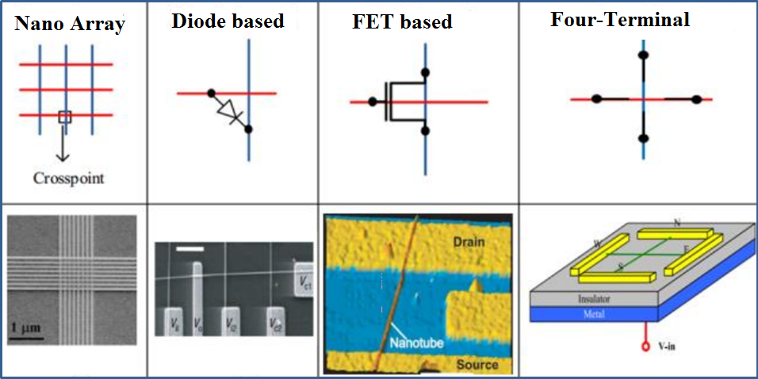
Modelling Nano-Crossbar Arrays
Nano array and 3 different crosspoint models

Slide 11

Two-terminal vs. Four-terminal
Shannon’s work: A Symbolic Analysis of Relay and Switching Circuits(1938)

Slide 12
Two-terminal vs. Four-terminal

Slide 13
Specifics of MCSA RISE
Evaluation is mostly based on research excellence
  Propose with a good research idea
Money only for secondments/exchanges: 4500EURO per month
  Straightforward funding, 4500 for everything
  No secondment no money
  Seconded researchers should be employees in the sending organization
Cooperation between partners is the crucial part of RISE.
  Find good and attractive partners
  Large consortium is a plus
Although RISE is constructed on exchanges, you are expected to conduct productive research with publications/patents
  Have another project to support RISE
    Need funded researchers/scholars to work hard throughout the duration of the RISE project
    Need extra research money especially for experimental works

Slide 14
Lessons Learned
PREPERATION
  Formation of the consortium
    Decision: industry partner or third country
    Faced Problem: only SME’s are eligible as industry partners
    Faced Problem: 2000EURO per month is not satisfactory for industry employees
    Faced Problem: a partner withdrawing
  Start writing the proposal at least 1 month before the deadline
  Have a support from your university and TUBITAK
IMPLEMENTATION
  Difficulty of finding researchers to send
    Have a project covering different research areas
    Have a sizable research group
  Difficulty of keeping the harmony between partners
    Joint papers, conference presentations, visits
  Attend coordinators’ days

Slide 15
Benefits of RISE
Building a network for long lasting collaborations
Quality research with publications
Invaluable experience in implementing a project with a consortium having many partners
Chance to find good international/national students
Chance to send your students to the partners
Being a reviewer for international projects
Considered as a reliable partner for future projects
Getting more into H2020 for future projects
Benefits from TUBITAK, being rich
Significantly contribute to your career development

Slide 16
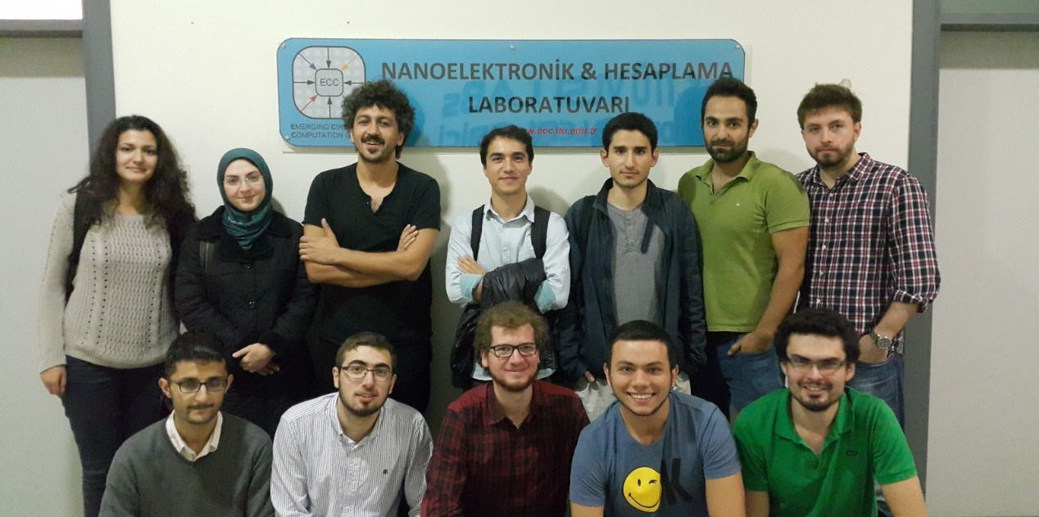
THANK YOU!
Web: http://www.ecc.itu.edu.tr/

