Slide 1

Circuit Design and Optimization of Nano-Crossbar Arrays
Mustafa Altun, PhD
Electronics & Communication Engineering
Istanbul Technical University
Web: http://www.ecc.itu.edu.tr/
June 4th, 2016
12th Nanoscience and Nanotechnology Conference (NanoTR-12)

Slide 2


Project Details
Gathers globally leading research groups working on nanoelectronics and EDA
Targets variety of emerging technologies including nanowire/nanotube crossbar arrays, magnetic switch-based structures, and crossbar memories
Contributes to the construction of emerging computers beyond CMOS by proposing nano-crossbar based computer architectures.
Budget: 724500 EURO

Slide 3
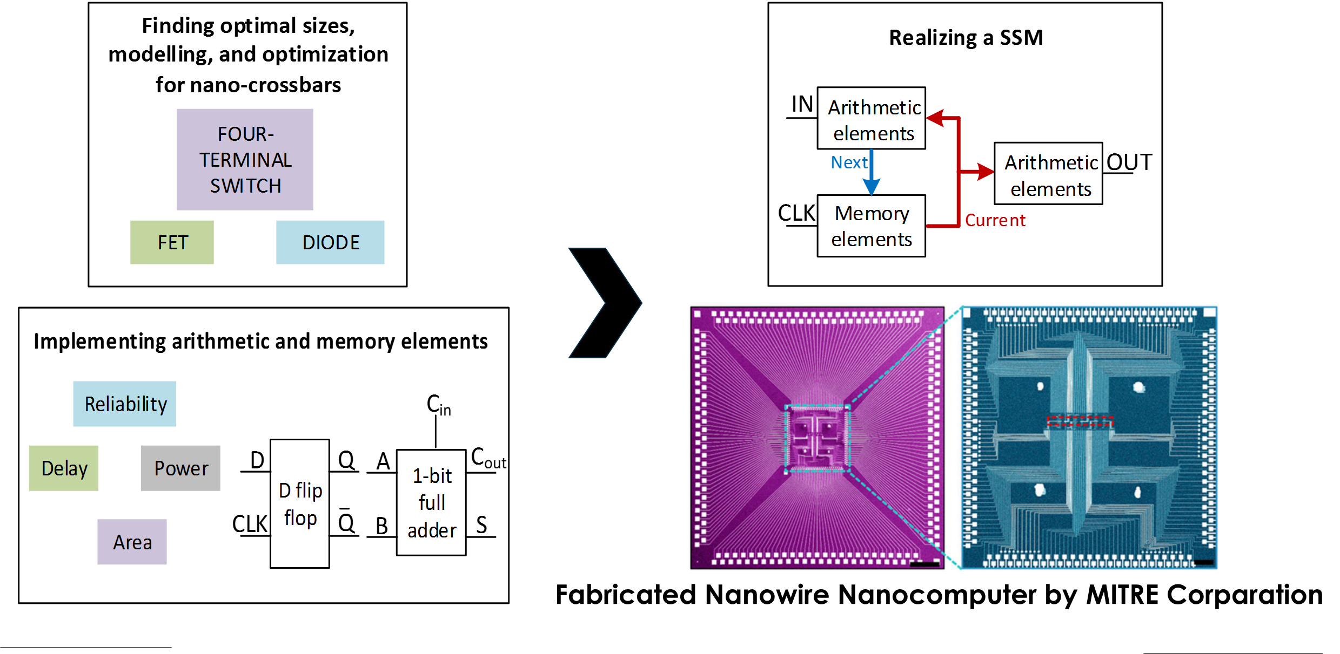
Project Details

Slide 4
Outline
Nano-crossbar arrays
Modeling nano-crossbar arrays and logic synthesis
  Diode based
  FET based
  Four-terminal switch based
Defect tolerance
R-C modelling
Performance optimization

Slide 5
Motivation
1963: CMOS
1965: Moore’s Law
  Transistor count doubles every year.
1975: Moore’s Law updated
  Transistor count doubles every two years.
2015: Gordon Moore: «I see Moore’s law dying here in the next decade or so»
2015: Intel confirming the slowdown in pace of advancement, from two to two and a half years.
  Uncertainty, probabilistic phenomena
  Fabrication challenges
New technologies emerge: nano-crossbar arrays

Slide 6


Emerging Transistors
Nanowire transistor
Single electron transistor
Carbon nanotube transistor
Spin based transistor
Quantum well transistor
Direct and safe replacement of CMOS transistors
Some advantages over CMOS
Interconnection problems
Lack of integration

Slide 7

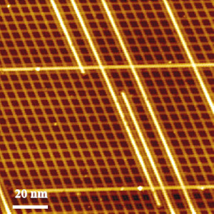
Nano-crossbar Arrays
Regular arrays
  Regularity; ease of design.
Nanotechnology
  Self-assembled systems.
Self-assembled circuit with 64,000 elements in three minutes
Self-assembled nanowires

Slide 8
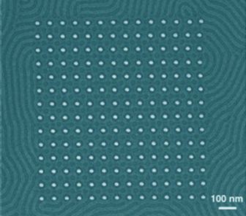
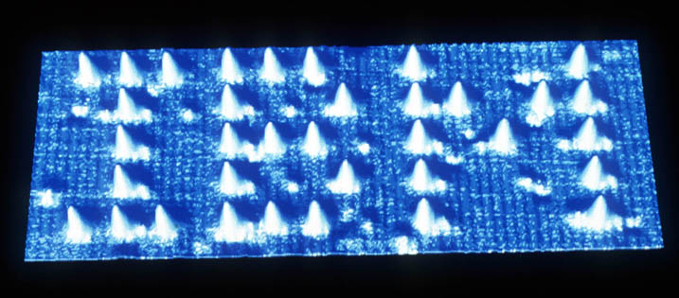
Why Self-assembly?
Directed assembly
  Advantages
    Results in a functional construct from a print/layout
  Disadvantages
    Costly in nanoscale
    Time consuming
Self assembly
  Advantages
    Fast and efficient in nanoscale
    Results in condensed structures
  Disadvantages
    Not results in a functional construct

Slide 9
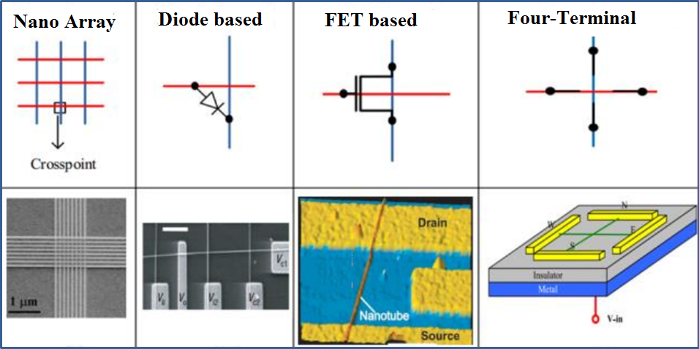
Modelling Nano-Crossbar Arrays
Nano array and 3 different crosspoint models

Slide 10
Diode-based Model

Slide 11
Diode-based Model
Example:
Implement the Boolean function f = A+B with diode based nanoarrays.
Diode-resistor logic

Slide 12
Diode-based Model
Example:
Implement the Boolean function f = A B with diode based nanoarrays.
Diode-resistor logic

Slide 13
Diode-based Model
Example:
Implement the Boolean function f = A B + C D with diode based nanoarrays.

Slide 14
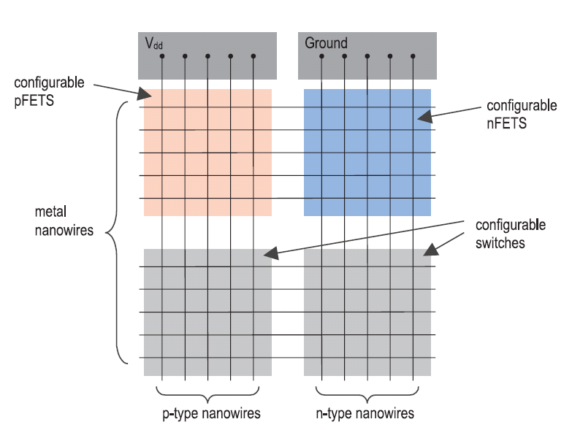
FET-based Model
From Snider, G., et al., (2004). CMOS-like logic in defective, nanoscale crossbars. Nanotechnology.

Slide 15
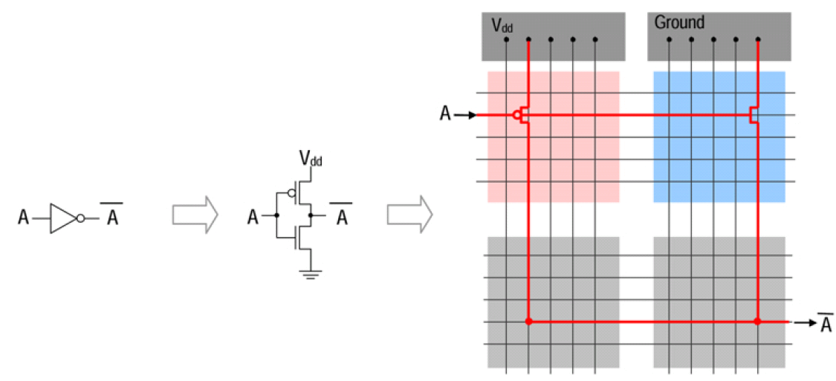
FET-based Model
Example:
Implement the Boolean function f = Aꞌ with FET based nanoarrays using CMOS-like logic.

Slide 16
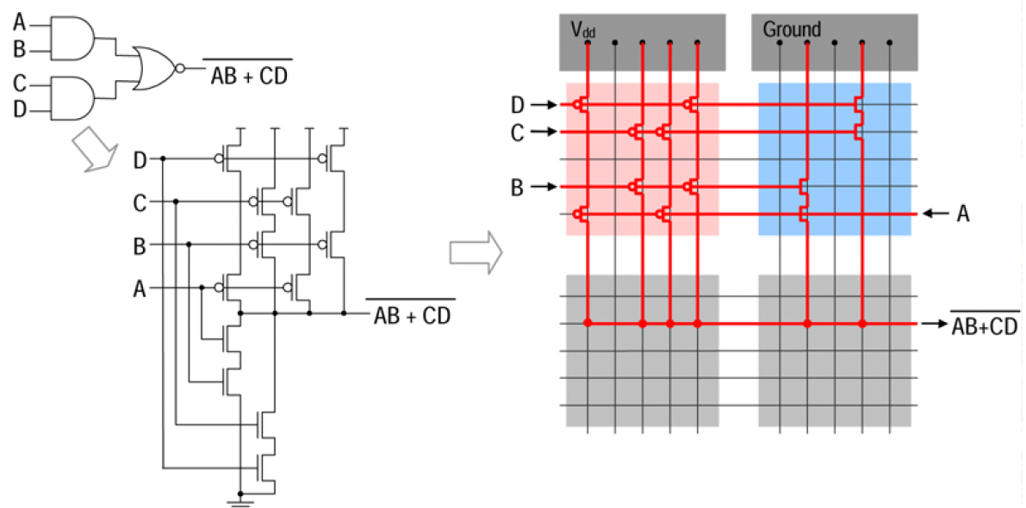
FET-based Model
Example:
Implement the Boolean function f = (A B + C D)ꞌ with FET based nanoarrays using CMOS-like logic.

Slide 17
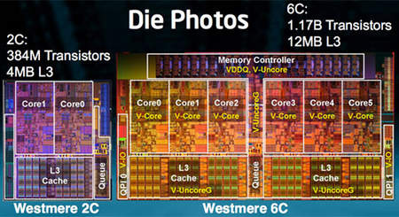
Two-terminal vs. Four-terminal
Shannon’s work: A Symbolic Analysis of Relay and Switching Circuits(1938)

Slide 18
Two-terminal vs. Four-terminal

Slide 19
Two-terminal vs. Four-terminal
What are the Boolean functions implemented in (a) ad (b)?

Slide 20
A Lattice of Four-terminal Switches
3 × 3 2D switching network and its lattice form

Slide 21
Four-terminal Switch-based Model
Switches are controlled by Boolean literals.
f_{L} evaluates to 1 iff there exists a top-to-bottom path.
g_{L} evaluates to 1 iff there exists a left-to-right path.

Slide 22
Logic Synthesis Problem
How can we implement a given target Boolean function f_{T} with a lattice of four-terminal switches?
Example: f_{T} = x₁x₂x₃+x₁x₄

Slide 23
Logic Synthesis Problem
Example: f_{T} = x₁x₂x₃+x₁x₄+x₁x₅
9 TOP-TO-BOTTOM PATHS!

Slide 24
Synthesis Method
Example: f_{T} = x₁x₂x₃+x₁x₄+x₁x₅
f_{T}^{D} = (x₁+x₂+x₃)(x₁+x₄)(x₁+x₅)
f_{T}^{D} = x₁ + x₂x₄x₅ + x₃x₄x₅
Start with f_{T} and its dual.
Assign each product of f_{T} to a column.
Assign each product of f_{T} ^{D} to a row.
Compute an intersection set for each site.
Arbitrarily select a literal from an intersection set and assign it to the corresponding site.

Slide 25
Synthesis Method

Slide 26
Math Behind the Method – Theorem 1
Theorem 1 (Altun and Riedel, 2010): If f_{T} and f_{T}^{D} are implemented as subsets of all top-to-bottom and left-to-right paths, respectively, then f_{L} = f_{T} and g_{L} = f_{T}^{D}.

Slide 27
Math Behind the Method – Theorem 1
Theorem 1 allows us to only consider column-paths. We do not need to enumerate all paths!

Slide 28
Math Behind the Method – Theorem 2
Lemma (Fredman and Khachiyan, 1996): Consider products P_{i} and P_{j} of f_{T} and f_{T}^{D} in ISOP forms, respectively. P_{i} ∩ P_{j} ≠ Ø
Theorem 2 (Altun and Riedel, 2010): Consider a product P_{i} of f_{T} in ISOP form. For any literal x of P_{i} there exists at least one product P_{j} of f_{T}^{D} such that P_{i} ∩ P_{j} = x.

Slide 29
Math Behind the Method – Theorem 2
Theorem 2 (Altun and Riedel, 2010): Consider a product P_{i} of f_{T} in ISOP form. For any literal x of P_{i} there exists at least one product P_{j} of f_{T}^{D} such that P_{i} ∩ P_{j} = x.
Each column is for each product!

Slide 30
Method’s Performance
The time complexity:
O(m²n²)
Size of the lattice: m×n
n and m are the number of products of the target function f_{T} and its dual f_{T}^{D}, respectively.

Slide 31
Experimental Results

Slide 32
Nano-Crossbar Arrays and Defects
Nano array and 3 different logic families
Defects are the main headache in nano arrays
Objective: Designing a fast heuristic algorithm for logic mapping on defective crossbars of 3 different logic families

Slide 33
Defects in Diode based Nano Arrays
Ideally
f = A B + C D
With a defect
f = A B + B C D
With a defect
f = A + C D
How to tolerate defects?
Each crosspoint is either closed (diode connected) or open.
What if a crosspoint is closed when it is supposed to be open?
What if a crosspoint is open when it is supposed to be closed?

Slide 34
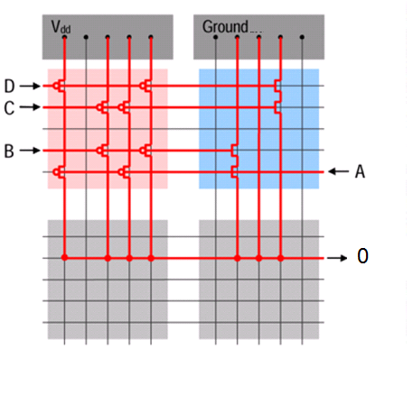
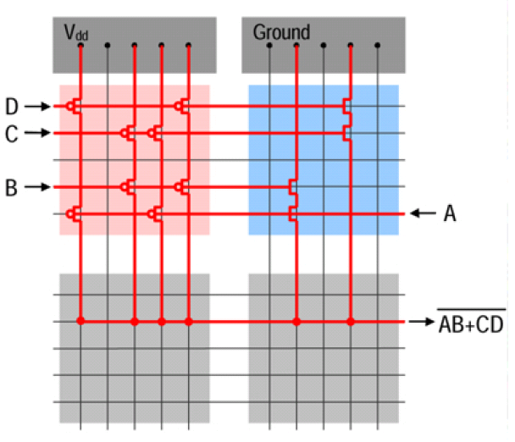
Defects in FET based Nano Arrays
Ideally
f = (A B + C D)ꞌ
With a defect
f = 0
How to tolerate defects?
Each crosspoint is either closed (MOS or shorted) or open.
What if a crosspoint is closed when it is supposed to be open?

Slide 35
Defects in Four-terminal Switch based Nano Arrays
Ideally
f = x₁ x₂ꞌ x₃+ x₁ x₄ꞌ + x₂ x₃ x₄ꞌ + x₂ x₄ x₅ + x₃ x₅
0
With a defect
f = x₁ x₂ꞌ x₃+ x₁ x₄ꞌ + x₂ x₃ x₄ꞌ + x₂ x₄ x₅ + x₃ x₅
1
With a defect
f = x₁ x₂ꞌ x₃+ x₁ x₄ꞌ + x₂ x₃ x₄ꞌ + x₂ x₄ x₅ + x₃ x₅
How to tolerate defects?
Each crosspoint is either closed or open depending on the applied literal.
What if a crosspoint is always closed when it is supposed to switch?
What if a crosspoint is always open when it is supposed to switch?

Slide 36
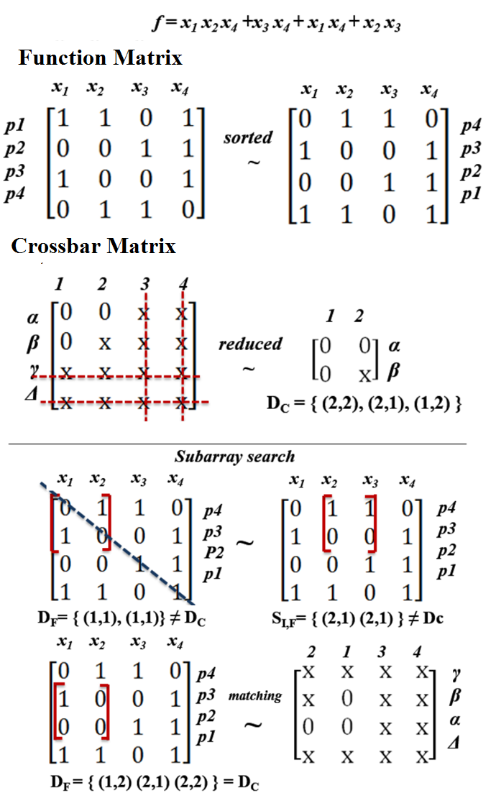
Proposed Algorithm
Algorithm Steps:
Sort function and crossbar matrix
Obtain reduced matrix
Start subarray search
Compare sets of double indices, if equal sets found in 20,000 trials there is a matching, otherwise not.
Key concepts:
Row and column permutations of matrix produce equivalent logic function.
Double index is (a, b) tuple which shows the number of same elements in a row and a column
Necessary and sufficent condition: If two matrices have the same set of double indices, then they are identical

Slide 37
Experimental Results
For each benchmark function, 600 crossbars are generated. 600 is chosen due to stabilization of tolerance fluctuations.
It takes 0.02 seconds in average to check a valid mapping that satisfies an accuracy of 99% compared with an exhaustive search.

Slide 38
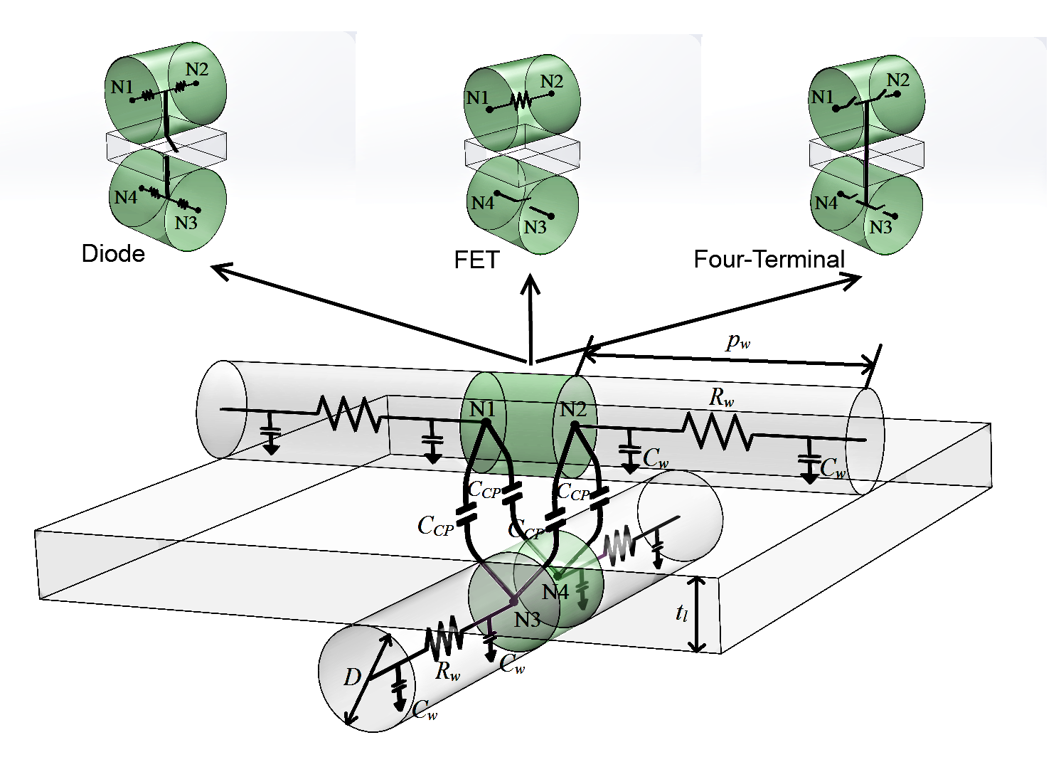
R-C Modeling of Arrays

Slide 39
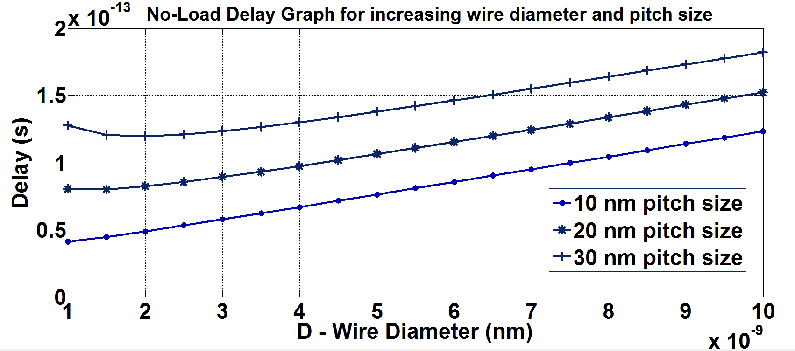
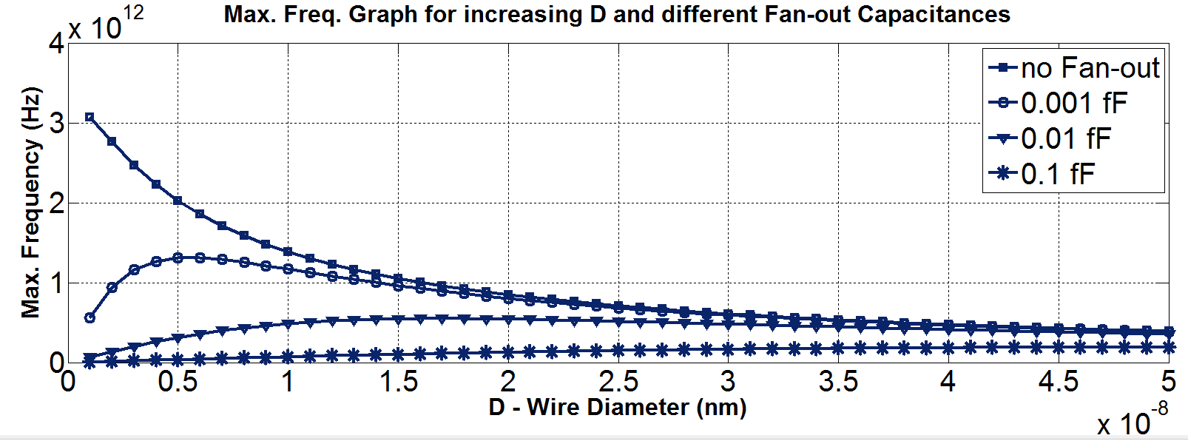
Performance Optimization

Slide 40
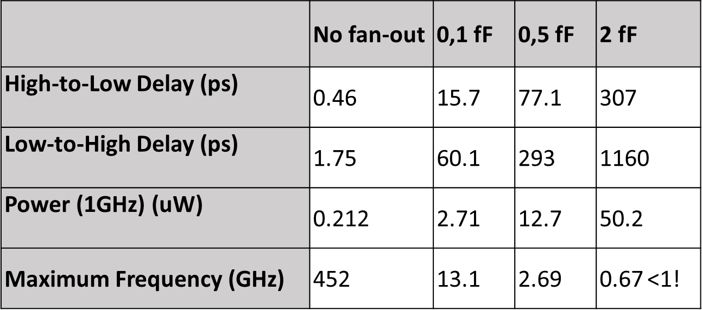
1-bit Full Adder Example

Slide 41
Future Works

Slide 42
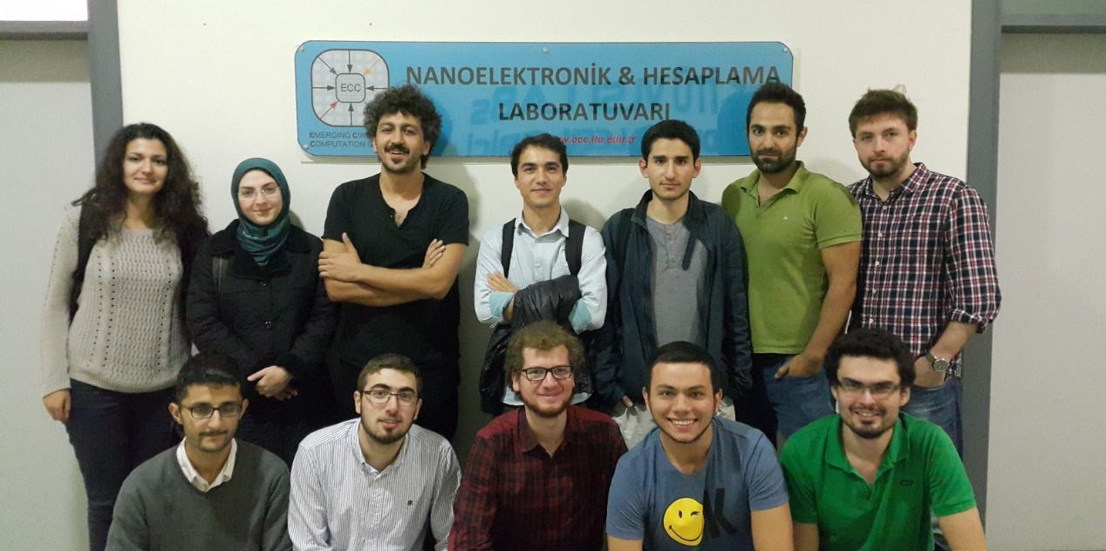
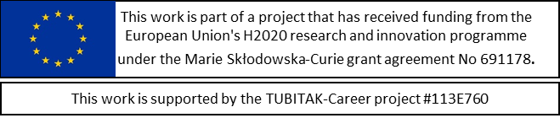
THANK YOU!
Web: http://www.ecc.itu.edu.tr/

