Slide 1
Synthesis and Optimization of Switching Nanoarrays
Istanbul
Technical
University
Muhammed Ceylan Morgul
Mustafa Altun, PhD

Slide 2
Outline
Introduction
Shannon, CMOS, Moore’s Law, Nano Scale Electronic
Self-Assembly Fabrication
Switching Nanoarrays
Implementation Methodologies and Size Formulations
Two-terminal Switch Based: Diode and CMOS
Four-terminal Switch Based
Optimization
Experimental Results
Future Work and Discussion
Conclusion

Slide 3
Introduction
1938: Claude Shannon’s thesis “A symbolic analysis of relay and switching circuits”
Carole Cable, www.cartoonstock.com

Slide 4
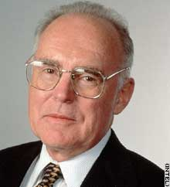
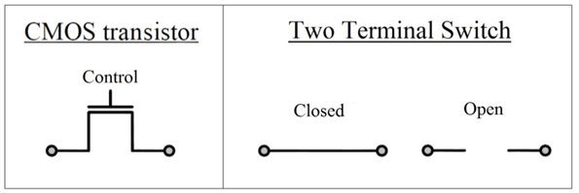
Introduction
1963: CMOS
1965: Moore’s Law
In every twelve months, number of elements in an IC (Integrated circuit) would be duplicated.
Even Gordon Moore himself claimed in 2005 that the validity of Moore’s Law will be lost.
transistor’s physical working limits

Slide 5
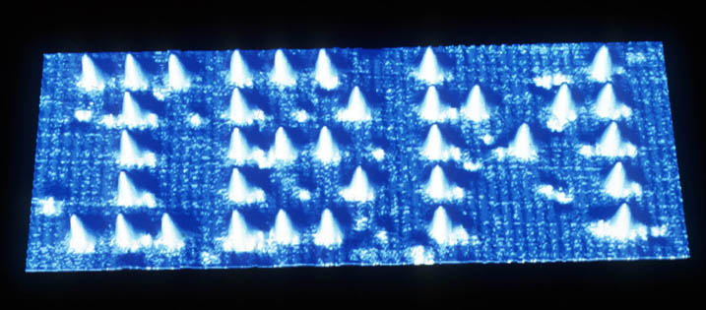
Introduction
Nano Scaled Technologies
Single-electron transistors, quantum circuits, nanowires…
Molecular and DNA computing
Bottom-Up vs Top-Bottom Fabrications
Self-Assambly fabrication
Cheap
Ordered/Regular shaped
Ex: Nanoarrays
A Boy And His Atom: The World's Smallest Movie, IBM
“Solar cells made through oil-and-water 'self-assembly”, http://news.bbc.co.uk, 2010

Slide 6
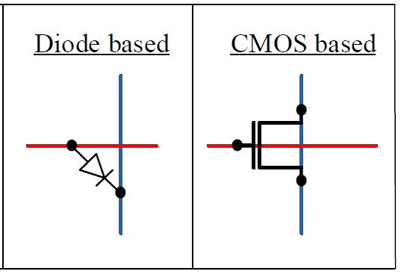
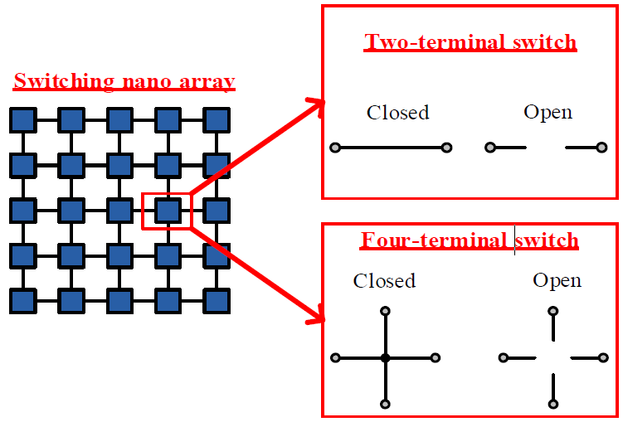
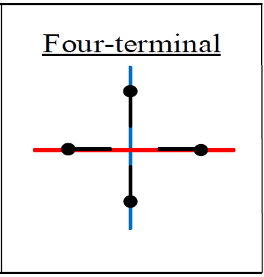
Introduction
Switching Nanoarray

Slide 7
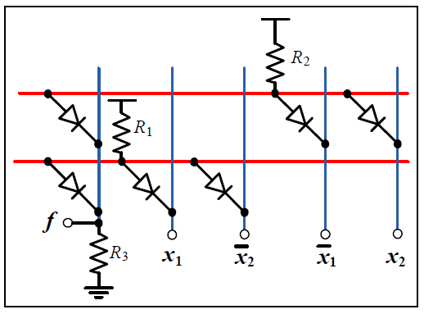
Implementation Methodologies
Diode Based Switched Nanoarray
XOR₂ = x1⊕ x2
Array Size = (number of products in f ) x (“number of literals in f ”+ 1)

Slide 8
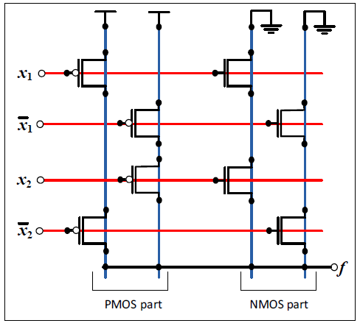
Implementation Methodologies
CMOS Based Switched Nanoarray
XOR₂ = x1⊕ x2
Array Size = (number of literals in f ) x
(“number of products in f ” + “number of products in f D”)

Slide 9
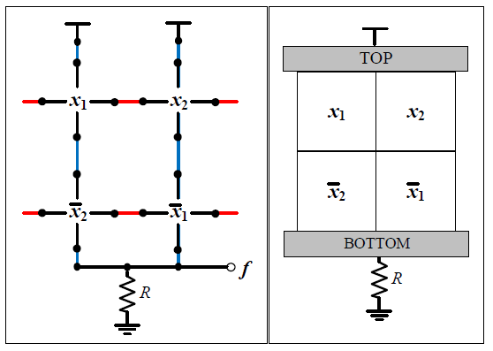
Implementation Methodologies
Four Terminal Switched Nanoarray
XOR₂ = x1⊕ x2
Array Size = (number of products in f ) x (number of products in f D)

Slide 10
Optimization
for Four Terminal Switched Nanoarray
Algorithm steps:
Determine Upper Bound and Lower Bound for the function
The Implementable Nanoarray Shapes’ List
The list is sorted in terms of array size
Check the shapes in the list
Starting from the beginning of the list
Declare Optimal Size

Slide 11
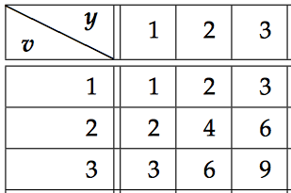
Optimization
(Example)
Target Function: XOR₃ = x1⊕ x2 ⊕ x3
It and its dual have 4 # of products
UB = 4x4 = 16, LB = 9 (from the table)
The List: 3x3, 3x4, 4x3 and 4x4
Lower Bound Table
Altun and Reidel, Logic Synthesis for Switching Lattices, 2012

Slide 12
Optimization
(Example continue)
Target Function: XOR₃ = x1⊕ x2 ⊕ x3
The list: 3x3, 3x4, 4x3, 4x4
Check the target function can be realized in 3x3 or not
3x3 is the optimal solution
X1 | X2 | 1
0 | 0 | 1
0 | 1 | 0
X1 | X3 | X1’
X2’ | 1 | X2
X1’ | X3’ | X1
X1 | X2 | 1
X2 | 0 | 0
X1’ | 0 | 0

Slide 13
Optimization
Improvements
Subdesign Library
Particular product
# of literals conflict for designs
X1 | X3
X2’ | 1
X1’ | X3’
X1’ | 0
X2 | 0
X1 | 0
X1 | 0
X1 | X2
1 | 0
Discarded since has product X1
(e.g. with 6 variable in 3x4)

Slide 14
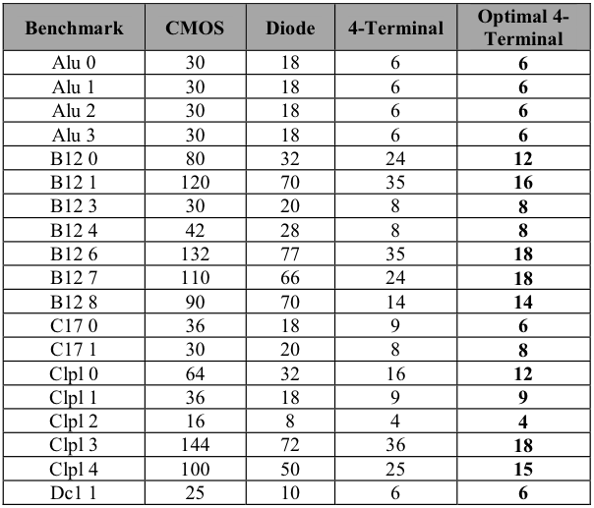
Experimental Results

Slide 15
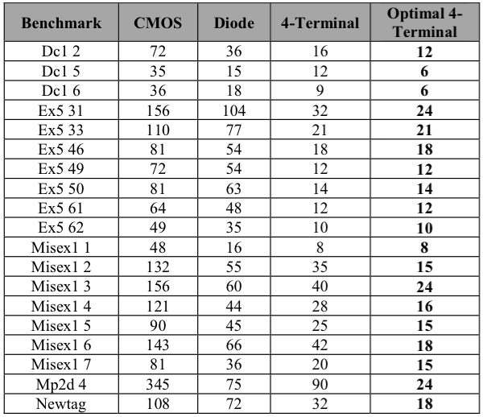
Experimental Results

Slide 16
Future Work and Discussion
The Sub-design Improvement makes the algorithm roughly 400 times faster for XOR₃ (in 3x4)
Algorithm is implementable for any function,
but needs improvements to be more usefull for complex functions

Slide 17
Conclusion
Investigations of Nanoarray Types
Two and Four Terminal Switch Based
Size Formulation for Function Realization
Diode and CMOS are optimum, Four-Terminal is not
Optimization for Four-Terminal
Comparison of Array Sizes of Nanoarray Types
Using some Benchmark Functions

Slide 18
Thank You All
Istanbul
Technical
University
The Scientific and Technological Council of Turkey,
Career Program
#113E760.
Emerging
Circuits and Computation Group

